Slide 1


The Canada Revenue Agency Innovation Centre
Blockchain on Cloud Workshop

Slide 2

Welcome to
Blockchain on Cloud Workshop
Innovation Centre
Cloud Center of Expertise
Innovation & Emerging Technologies (IET)
SOA COE/Cloud COE/Interoperability
Strategic Engineering & Technology Integration Division (SETI)
Solutions Architecture & Integration Directorate (SAID)

Slide 3
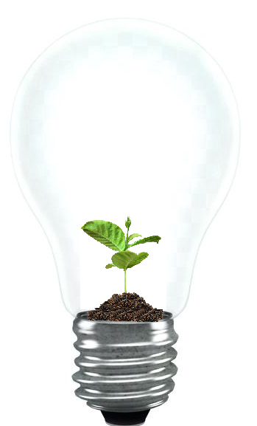
Innovation Center
Innovation Enablement
PoC
PoC Kit
DLT / Blockchain
Cloud/Tools support
AI /Machine Learning
Agile Centre of Expertise
Robotic Process Automation
DevOps
Notes:
https://confluence.isvcs.net/display/ITBIET/Innovation

Slide 4

Introduction
Name
Role
Expectations

Slide 5
Workshop Agenda
Items | Time (mins)
1. Sign-on | 5
Introduction | 15
3. Cloud/Azure introduction | 10
4. Cloud connection setups | 20
5. Introduction to Blockchain | 30
6. Hands on lab
a. Run setup scripts | 30
b. Playground – simple business network | 15
c. Export BNA and run in on a real fabric network | 15
d. Generate RESTful API | 15
e. View and interact with Blockchain via explorer | 15
f. Generate Angular APP | 15
g. View and interact with Blockchain | 15
7. Q/A – Feedback | 10

Slide 6
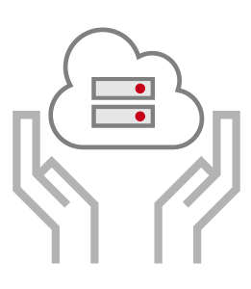
Cloud Center of Expertise
Introduction to CoE
Introduction to Azure Cloud
How to setup connection to Azure cloud workshop environment.
Notes:
Handover to CoE team – 10-15 mins max.

Slide 7
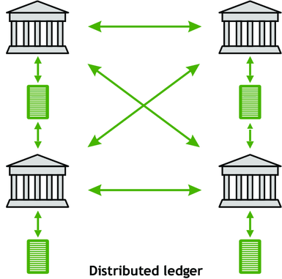
What is Blockchain?
Peer-to-Peer
Distributed ledger
Cryptographically-secure
Append-only
Immutable
Updateable via consensus
Public or private

Slide 8
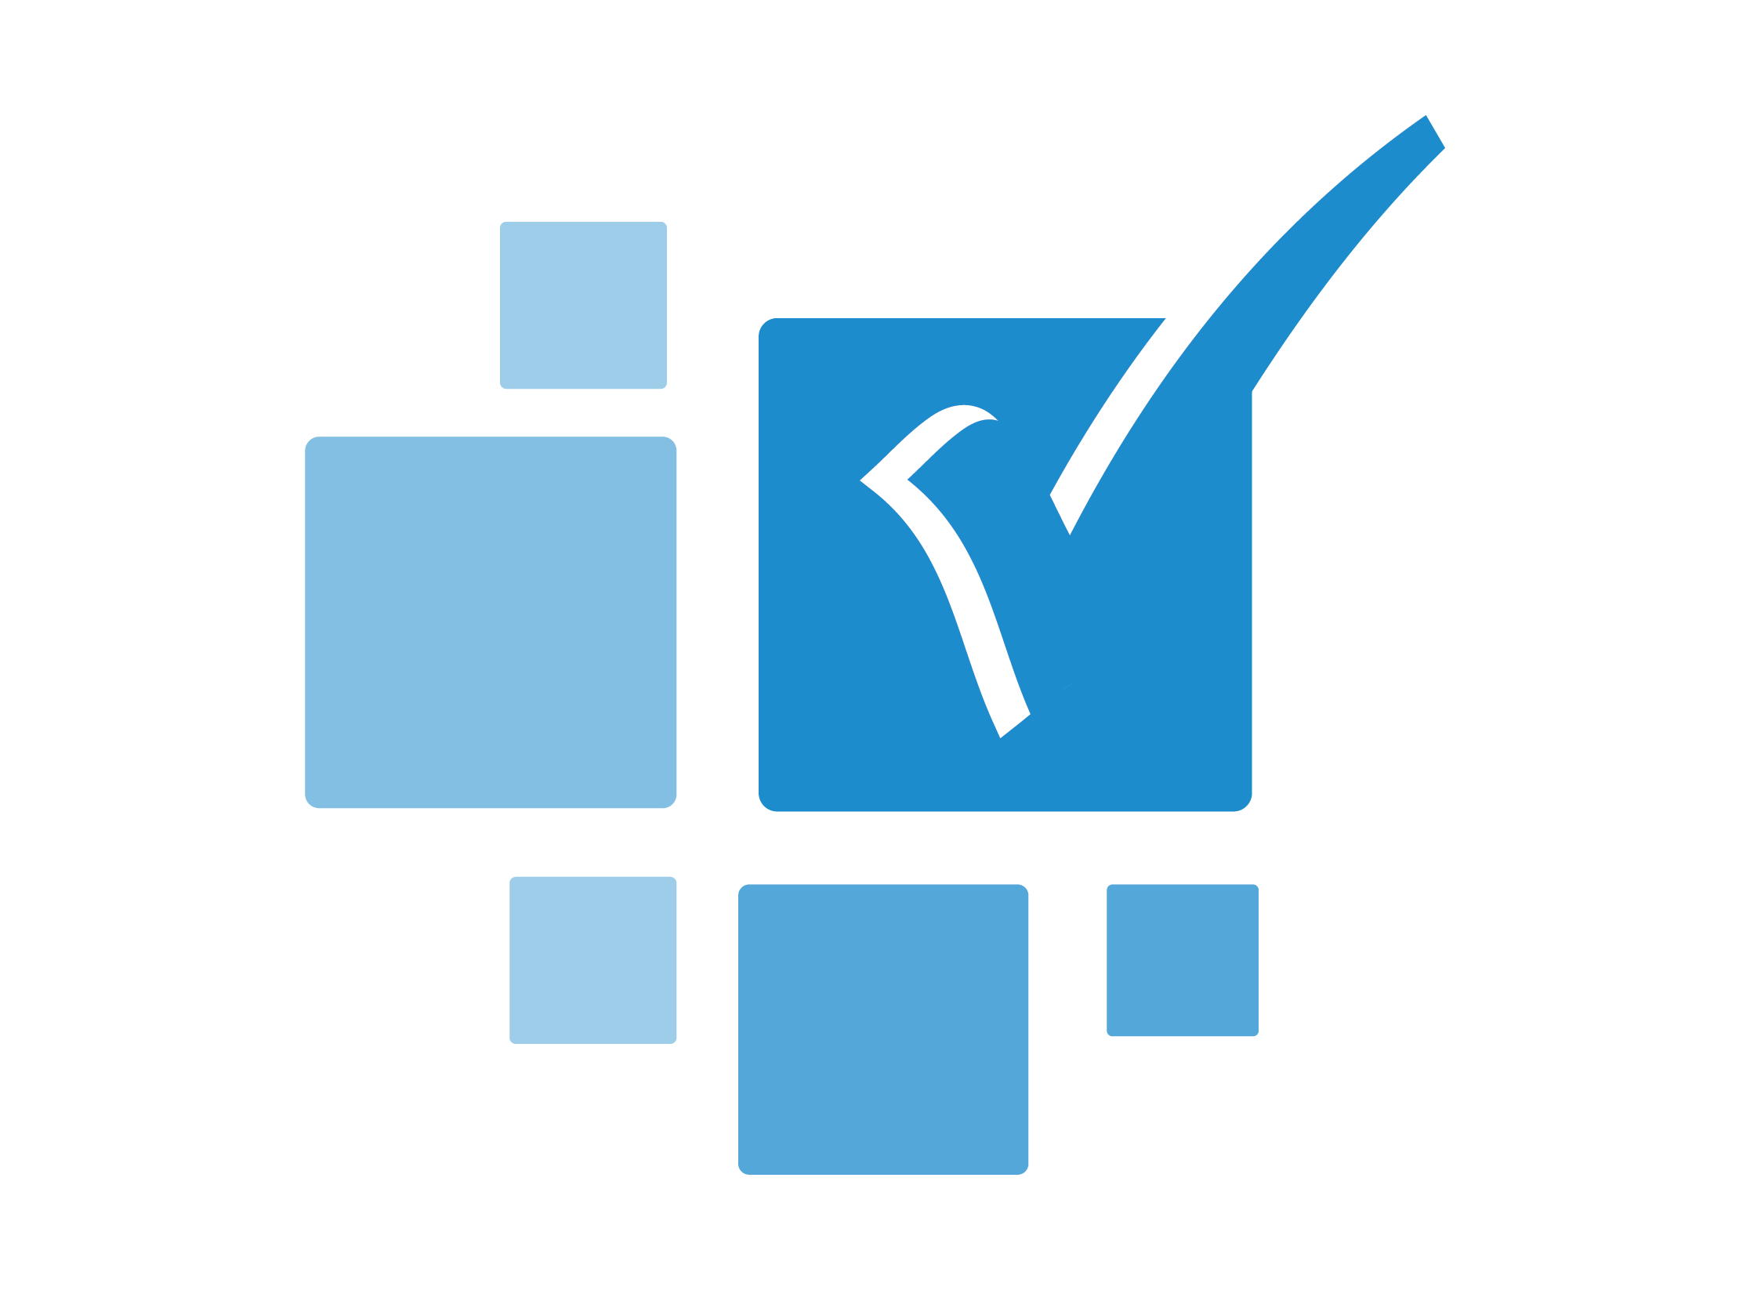
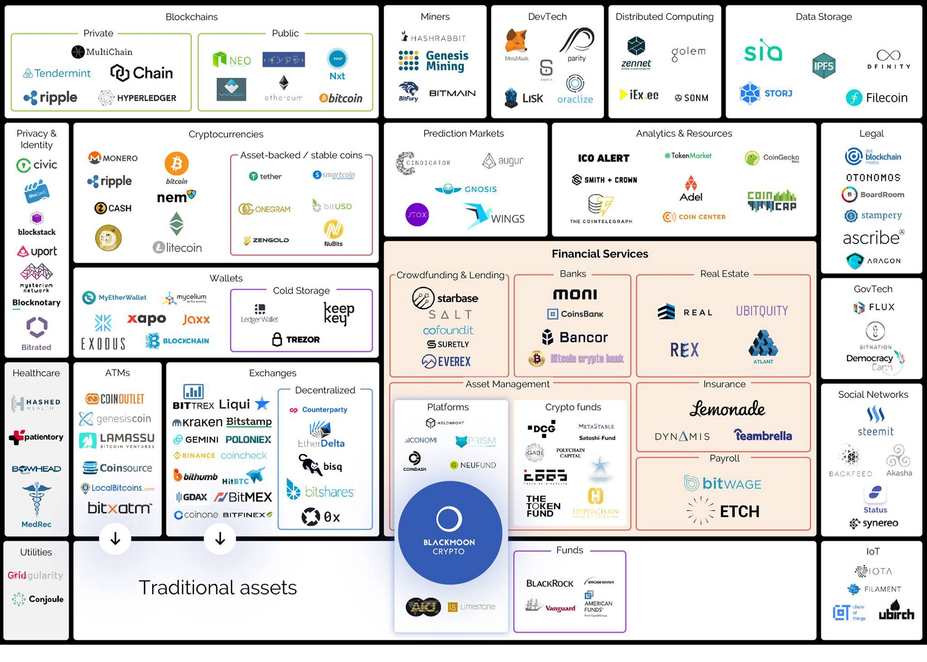
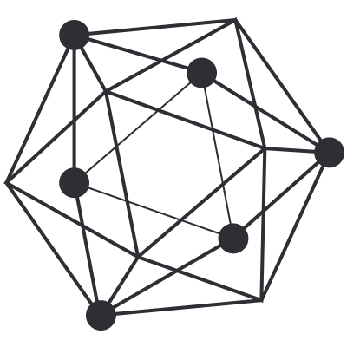
Platform Architectures and Implementation Styles
Hyperledger

Slide 9
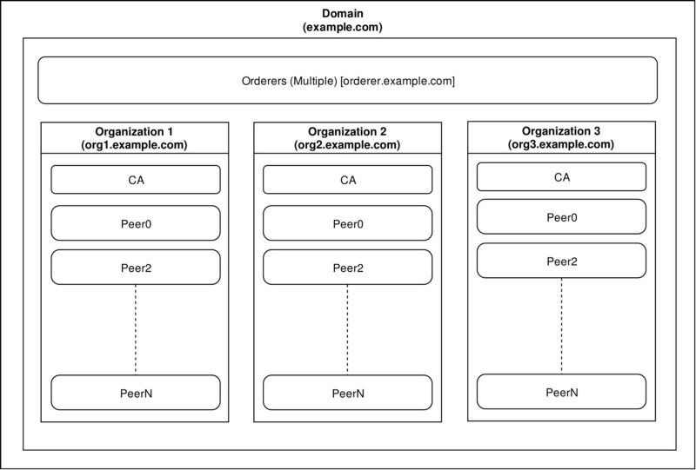
Hyperledger Fabric

Slide 10
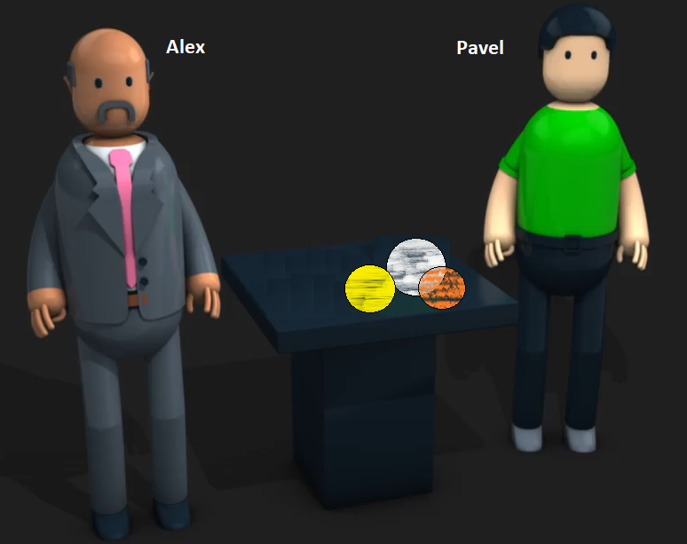
How Blockchain works
Pavel and Alex are on a Blockchain network and Pavel wants to trade one of his marble to Alex
Transaction
Participant
Pavel
Yellow Marble
Asset
Participant
Alex

Slide 11
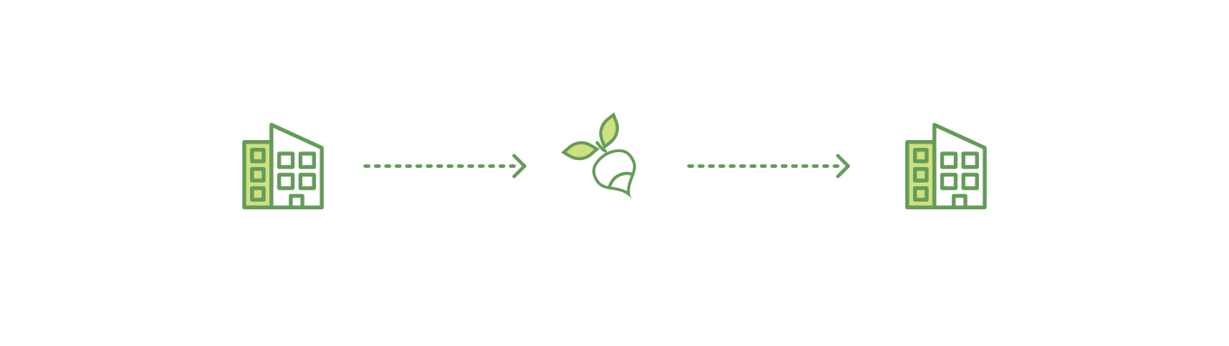
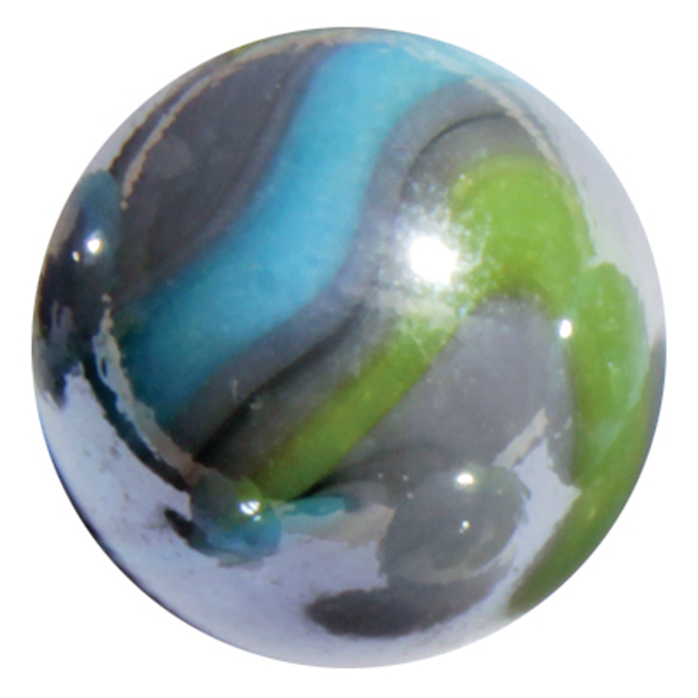
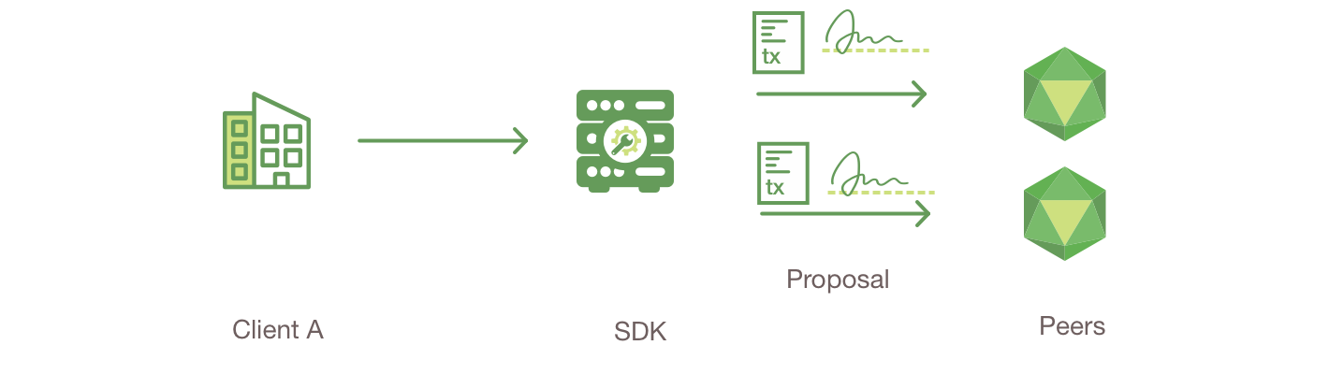
Transaction Flow – Smart Contract
Pavel
Alex
Chain
Transaction
Pavel

Slide 12
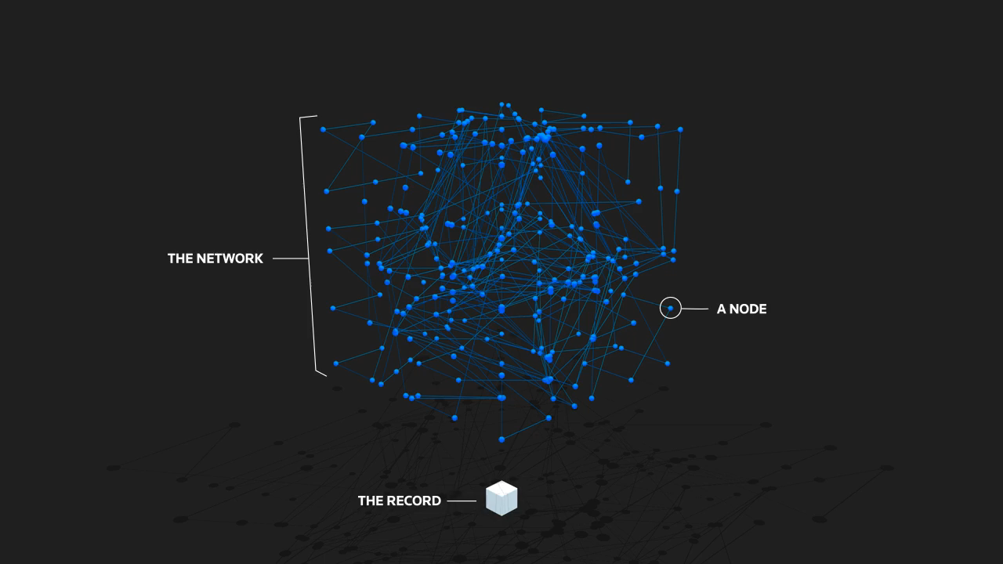
Transaction Flow
Visuals are from http://graphics.reuters.com/TECHNOLOGY-BLOCKCHAIN/010070P11GN/index.html

Slide 13
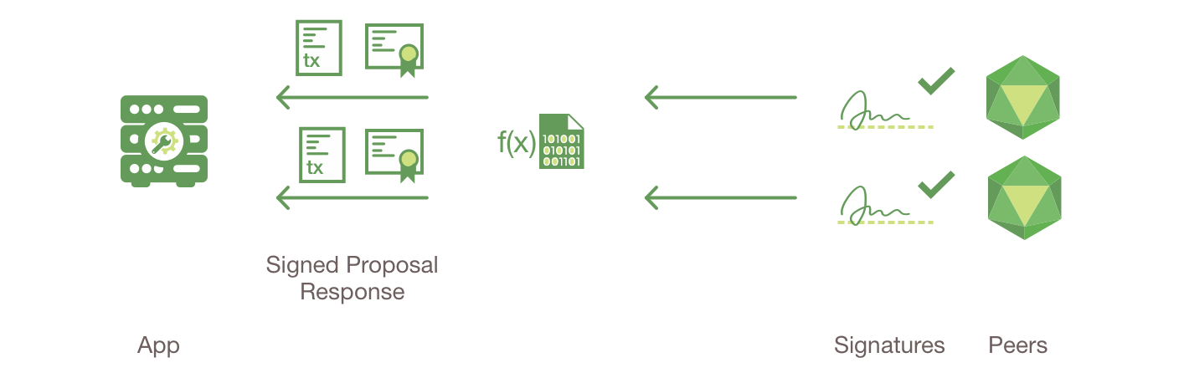

Transaction Flow - Consensus

Slide 14
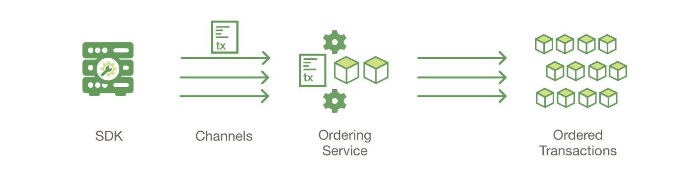
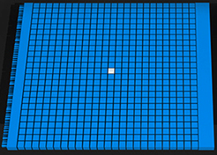
Transaction Flow – Creating Block

Slide 15
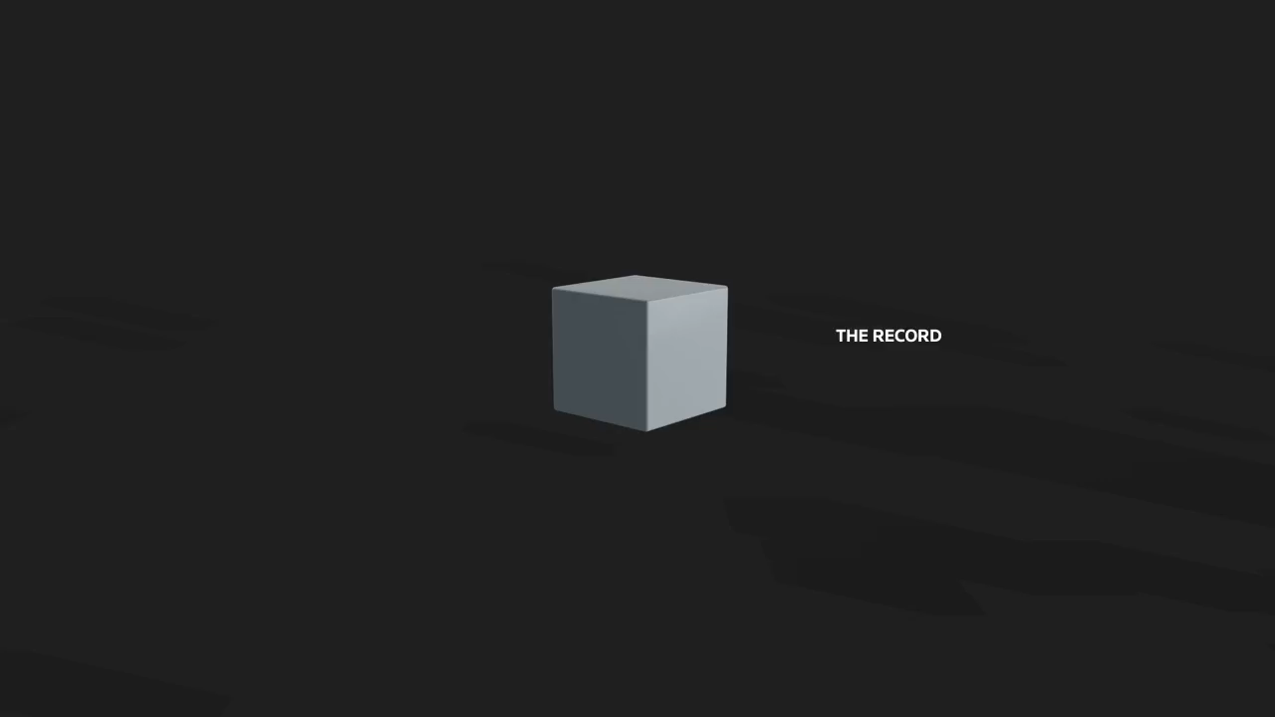
Transaction Flow – Creating Block
Visuals are from http://graphics.reuters.com/TECHNOLOGY-BLOCKCHAIN/010070P11GN/index.html

Slide 16
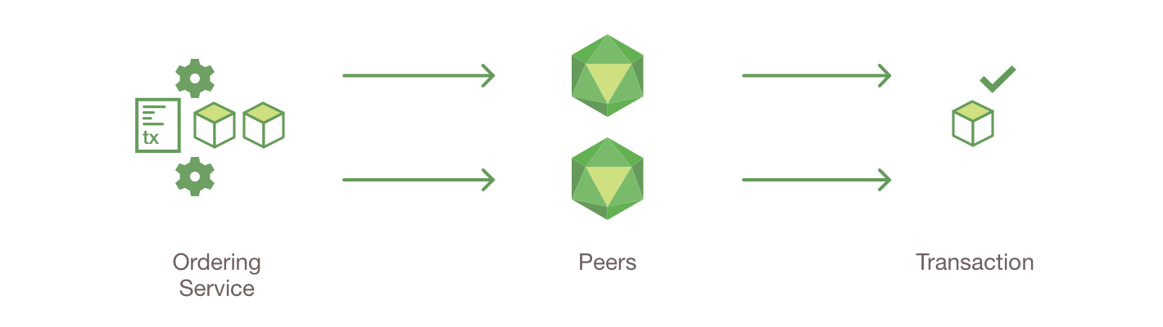
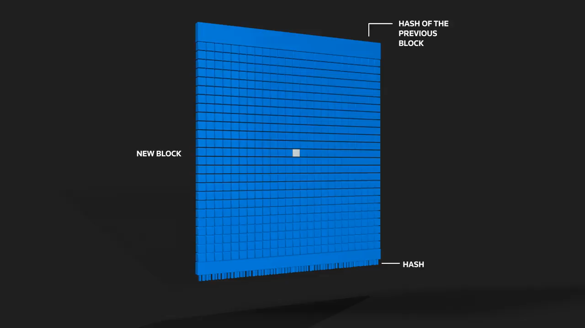
Transaction Flow – Add Block to chain
Visuals are from http://graphics.reuters.com/TECHNOLOGY-BLOCKCHAIN/010070P11GN/index.html

Slide 17
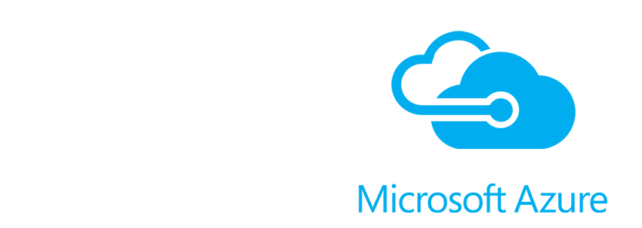

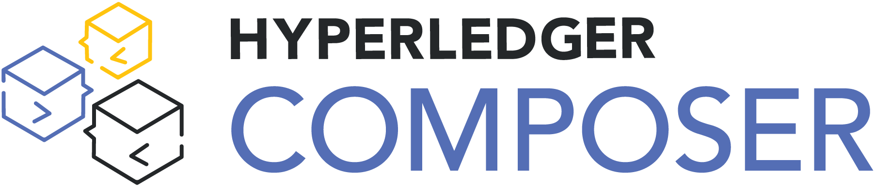
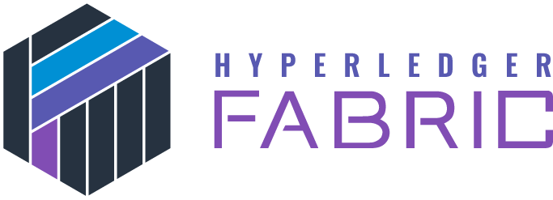
Workshop focus

Slide 18
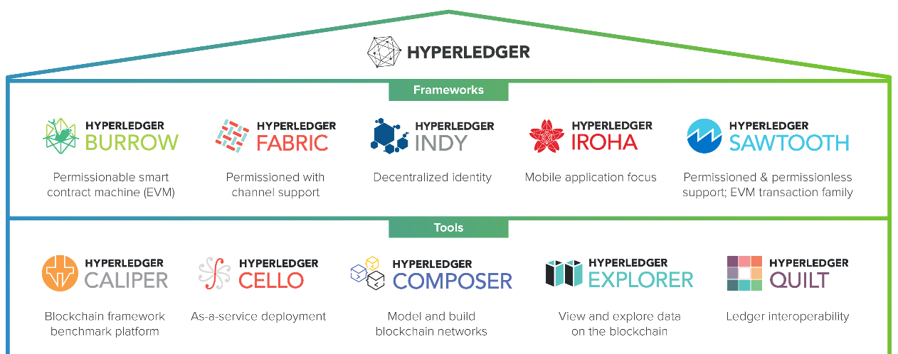
The Hyperledger Greenhouse
The modelling language
RESTful API
Syntax highlighting
Application generation using the Yeoman framework
playground
JavaScript based transaction logic

Slide 19

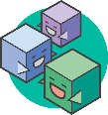
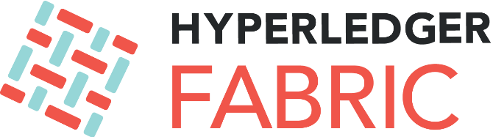

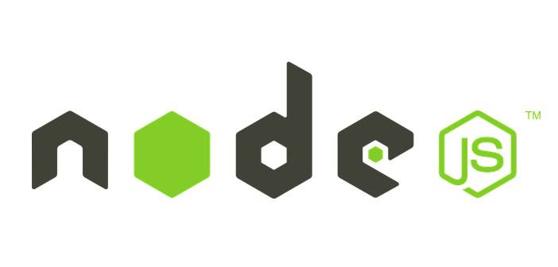


/ Blockchain development environment
What are we building today?
Angular 6 - Web Application
Composer REST APIs
Hyperledger Composer
Marbles Network
Org1
CA
Order
Peer
Docker /Docker Compose
Runtime
NPM
Python
Go

Slide 20
More information on Wiki
ITB-DGI-IETS/SINT
Workshop materials can be found on:
https://confluence.isvcs.net/display/ITBIET/Blockchain+Workshop
Innovation Centre:
https://confluence.isvcs.net/display/ITBIET/Innovation
https://confluence.isvcs.net/display/ITBIET/Innovation+Enablement
https://confluence.isvcs.net/display/ITBIET/Agile+Centre+of+Expertise

Slide 21
Questions?

